Slide 1

Single cycle RISC processor For Prof. Dr. Gihan Naguib Associate Professor, Department of Electrical Engineering. Eng. Jihad Awad Teaching Assistant, Department of Electrical Engineering
Fayoum University Faculty of Engineering Electronics & Electrical
Communications Department

Slide 2
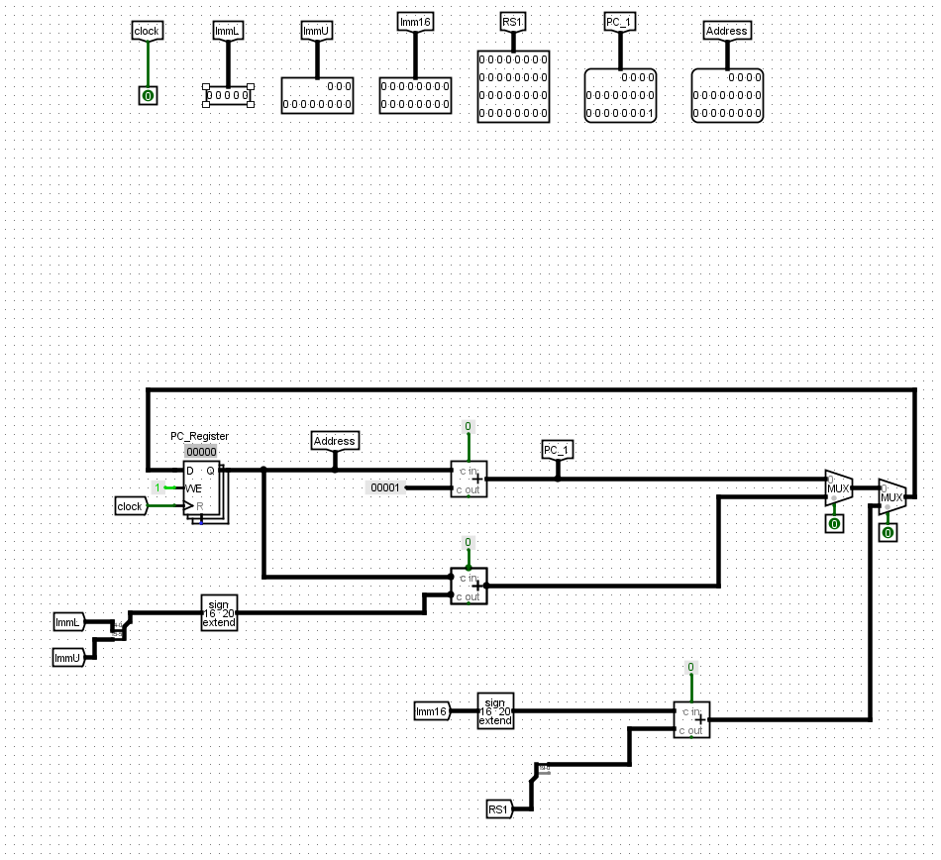
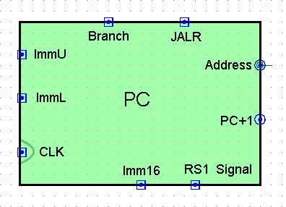
Program Counter
How It Works: The PC starts with an initial address (e.g., 0x0000). On each clock cycle (CLK), it either increments by 1 (PC+1) for sequential execution or updates to a new address for jumps/branches using Imm16 or JALR.

Slide 3
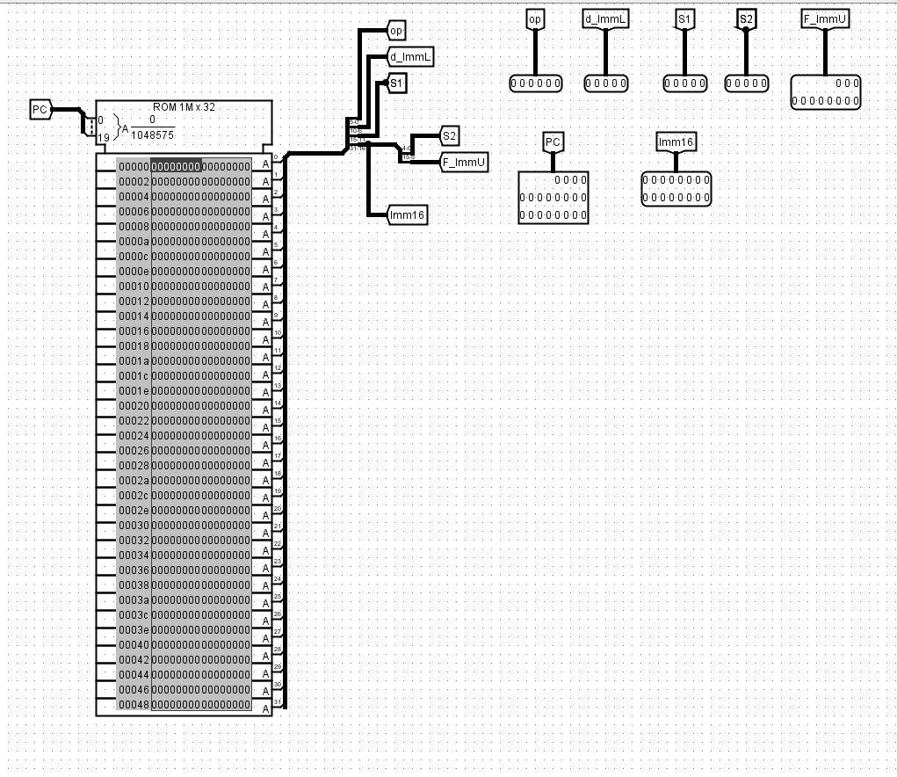
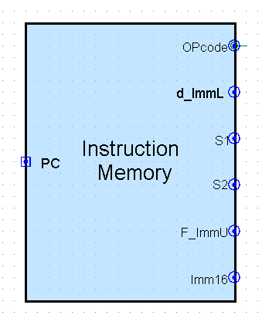
Instruction Memory
Role: Stores program instructions to be executed by the CPU.
How It Works:The Instruction Memory fetches a 32-bit instruction from the address provided by the PC on each clock cycle and sends it for decoding.

Slide 4
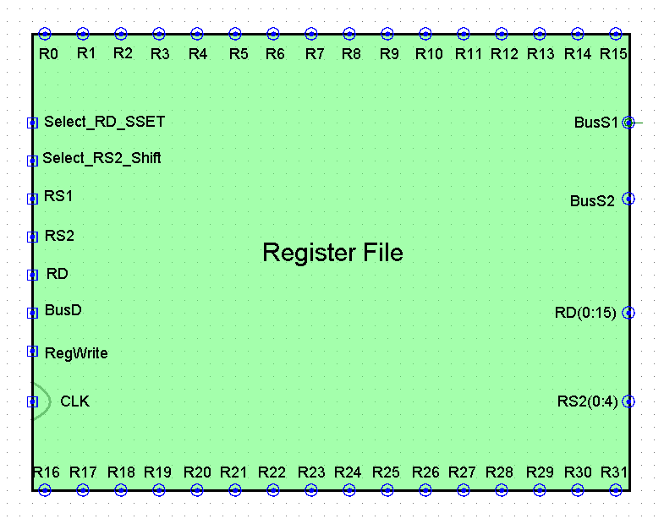
Register File
Diagram Overview: This FPGA design, created in a tool like Quartus, illustrates a register file (RF) implementation for a processor.
Register File (RF): Central block with 32 registers (R0-R31), each 32 bits wide, for data storage.
Registers are organized in a grid, connected via buses for reading/writing.
Control signals manage data flow and register selection.

Slide 5
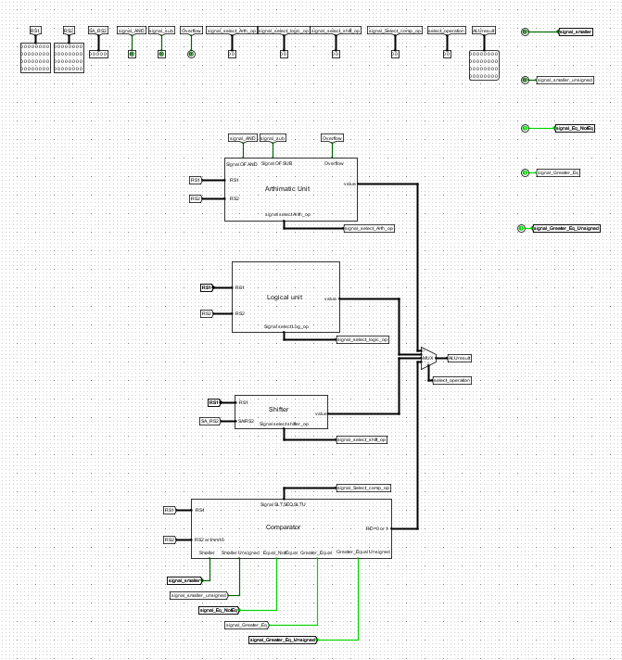
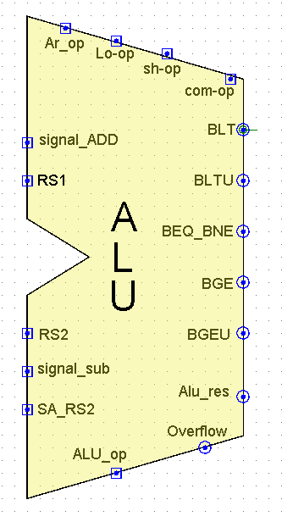
ALU
The ALU in this FPGA design Contains four blocks 1- Arithmetic block 2- Logical block 3- Shifter block 4- Comprator block

Slide 6
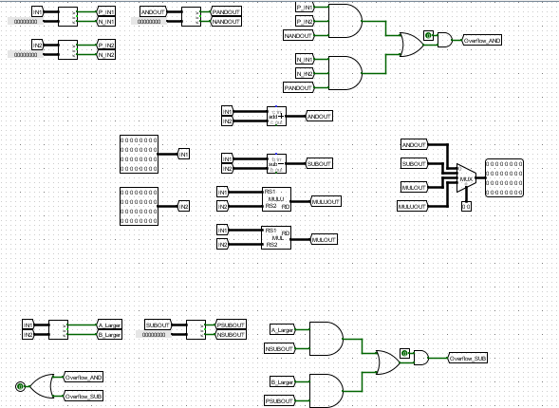
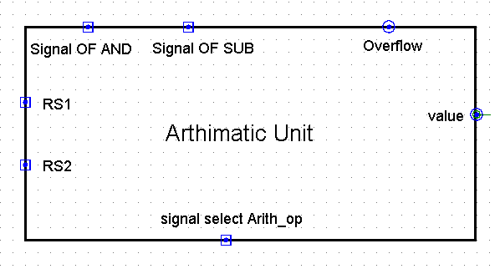
Arithmetic Unit
The Arithmetic unit performs four operations 1- Addition 2- Subtraction 3- Multiplication for signed number 4- Multiplication for unsigned number
It sends a signal to indicate an overflow condition.

Slide 7
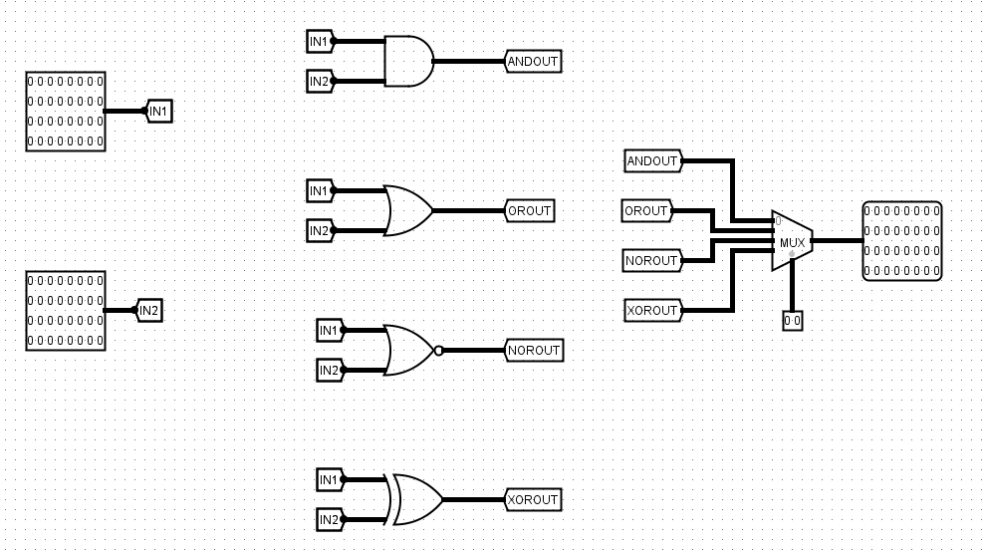
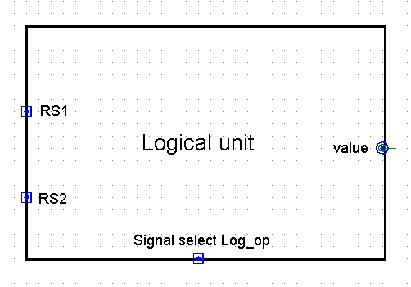
Logical Unit
The Logical unit performs four operations: 1- AND operation 2- OR operation 3- NOR operation 4- XOR operation

Slide 8
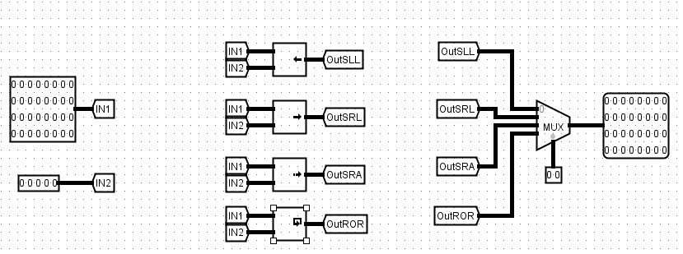
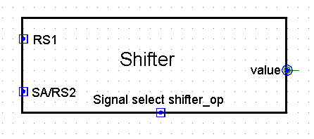
Shifter Unit
The shifter unit performs four operations: 1- Shift Left Logical 2- Shift Right Logical 3- Shift Right Arithmetic 4- Rotate Right

Slide 9
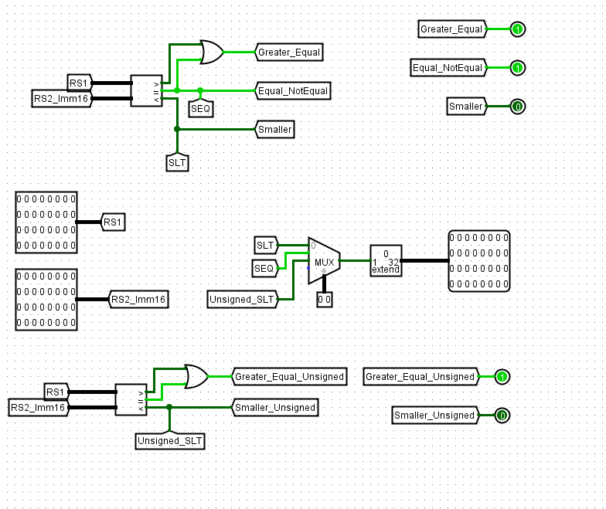
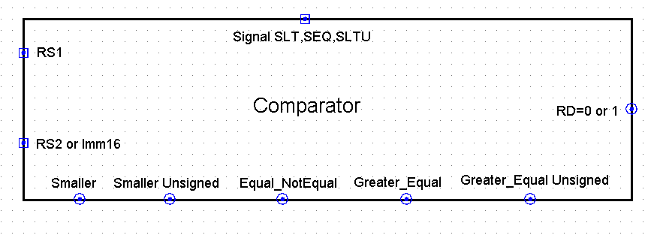
Comparator Unit
The Comparator unit performs operations: 1- Set less than 2- Set less than unsigned 3- Set equal
The Comparator unit generates signals: 1- Branch Equal and Not Equal 2- Branch Greater Equal 3- Branch smaller 4- Branch smaller unsigned 5- Branch Greater Equal unsigned

Slide 10
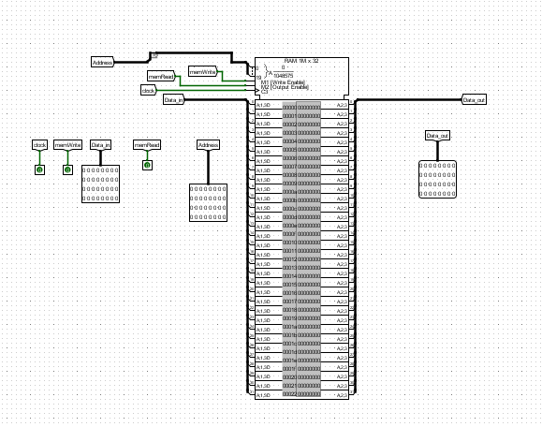
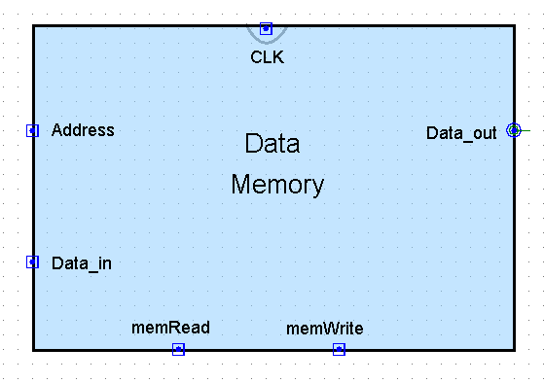
Data Memory
Role: The DM block acting as the main memory, stores and retrieves data for a processor while working with the RF for efficient data management.

Slide 11
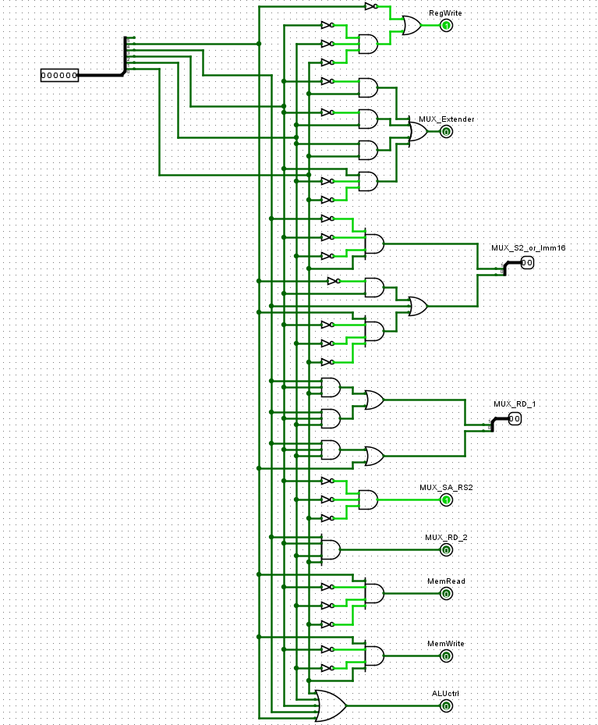
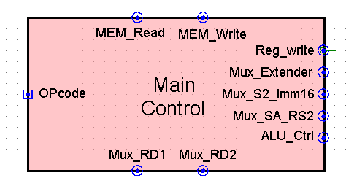
Main Control Unit
Role: The Main Control Unit (MCU) decodes the OPcode to generate control signals for the processor’s operation.

Slide 12
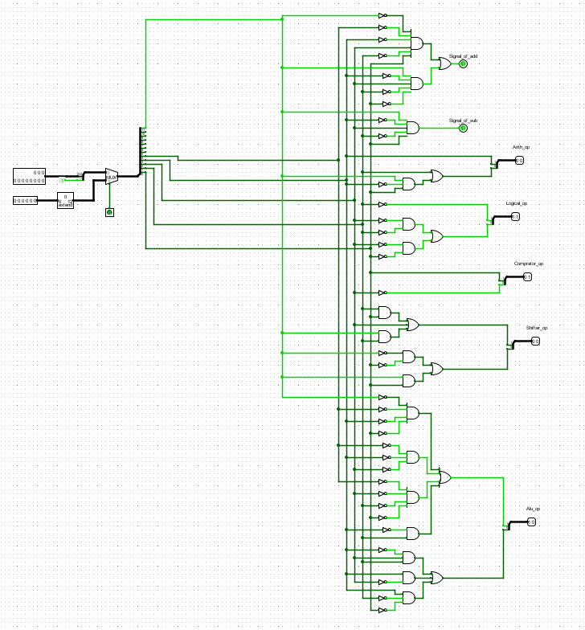
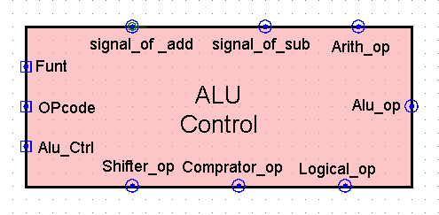
ALU Control Unit
Role: The ALU Control unit in this FPGA design generates specific operation signals for the Arithmetic Logic Unit (ALU) based on the OPCODE and Funct inputs.

Slide 13
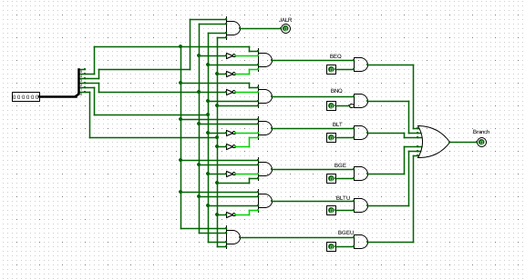
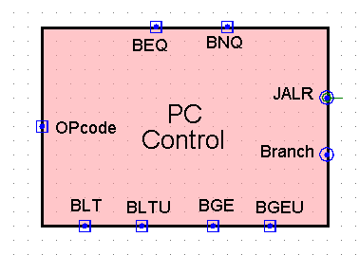
PC control Unit
Role: The PC Control unit manages program counter (PC) updates by determining branch conditions based on the OPCode

Slide 14


Thank You! This project reflects our dedication and teamwork
Meet Our Team:
Raghad Soliman Mohamed
Yusuf Mohamed Saleh Boriek
Abdulrahman Abdulnasser Abdulrahman ✨Great achievements come from great teamwork✨

